Slide 1
FYP Proposal Defense <<SMARTSERVE RESTAURANT>>
GROUP MEMBERS
S . No. | Enrollment # | Student Name
1 | 02-131192-046 | Muhammad Ahmed Bin Alam Rao
2 | 02-131192-056 | Sadia Ambreen
3 | 02-131192-059 | Muhammad Umer Farooque

Slide 2
Table of Contents
Introduction
Background
Problem Statement
Proposed Solution
Project Scope
Gantt Chart
References

Slide 3
Introduction
SmartServe Restaurant is a platform where you can reserve your table from home at restaurant.
There will be a Smart table at restaurant consists of tablet where customer can order food from menu and make payment online and ask for more services without calling the waiters.
Also can give feedbacks, instant complaints etc.
Customer’s order status, tracking, order patterns, are monitored.
Restaurant owner can monitor inventory, track orders and keep eye on financial matters.

Slide 4





Background
 | Feature # 1 Menu Management | Feature # 2 Reviews | Feature # 3 Online Reservations Smart table (consists tab ) | Feature # 4 Order status Tracking | Feature # 5 Stock (Inventory Management) | Feature # 6 Prepayments Dining Easy Payment
Foodo plane
Dine partner
The vista
OUR PROJECT ISERVE.com

Slide 5
Problem Statement
Traditionally the method in which customers specify their desired menu to the waiter who takes the order on a paper. He then takes the order to the kitchen department and then he supply the food item to the customer. So, it is a time-consuming process.
It also leads to wastage of paper and it requires reprinting of all menu cards too. For small changes in menu, its mandatory to reprint all the menu again and again.
Simply saying that the menu card once printed can’t be changed.
It is a headache for manager to keep the records of the inventory. How many products have been consumed and how much are left.

Slide 6
Proposed Solution
Features of the Project:
Online Reservations
Menu Management
Smart Menu Recommendation
Order and Status Tracking
Inventory Management
Table Management
Reporting & Analytics
Easy online Payments
Role base access control
Notify Waitlist
Reviews and feedback
Parcel Items

Slide 7
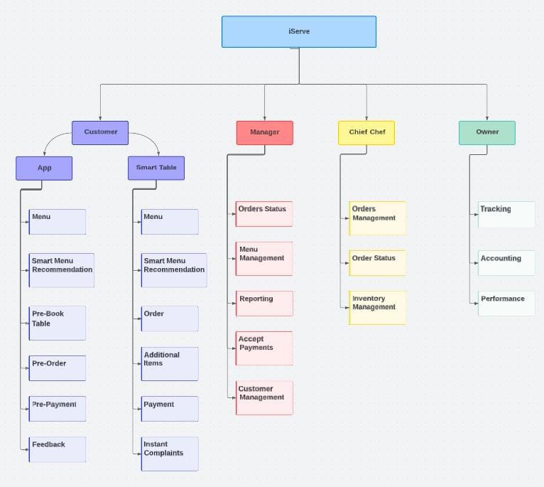

Slide 8
START
Reserve Table
Pre Order
Payment
Instant Complaint
Add on Order
Payment
Report Manager
END

Slide 9
Proposed Solution
Technologies to be used
ReactJs, MongoDb, NodeJs, ExpressJs, Python, Flutter.
Sustainable Development Goals Mappings
8-Decent Work And Economic Growth
12-Responsible Consumption and Production
17-Partnerships for the goals

Slide 10
Project Scope
Main areas to be covered
Food Menu Management.
Client/Customers Food ordering.
Inventory Management.
Smart Menu Recommendation.
Payments Automation.
A list of specific project goals, deliverables, features, functions and tasks.
Easy Client Ordering Management.
Easy Inventory Management.
Easy Order Status Management.
Secure payment and billing methods.

Slide 11
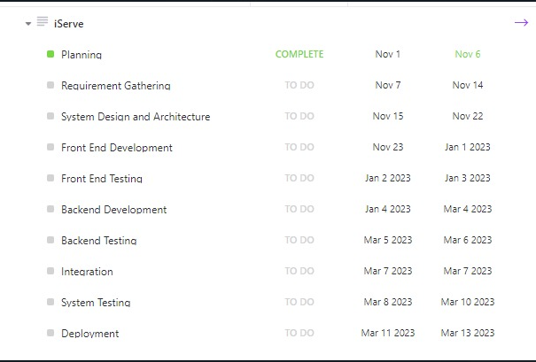
Gantt Chart

Slide 12
References
foodoplanet. 2022. foodoplanet. [online] Available at: < https://foodoplanet.com/listing-tag/takes-reservations/>
dinepartner.com. 2022.[online] Available at: < https://dinepartner.com/
thevista|. 2022. thevistarestaurant | thevista. [online] Available at: <https://www.thevistarestaurant.ca/

